Slide 1
Atoms, Elements, & the Periodic Table
Earth Science Intro Unit

Slide 2
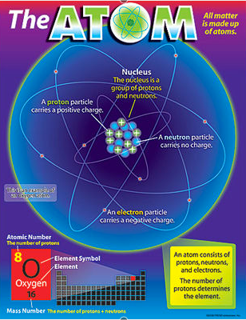
What is an Atom?
I will be able to describe and identify the parts that make up an atom.
Atom
Smallest particle into which an element can be divided and still be the same element
Building blocks of matter.
Make up everything around you.
Individual atoms are too small to be seen.
1 penny is made up of 2 x 10²² atoms.
20,000,000,000,000,000,000,000 atoms

Slide 3
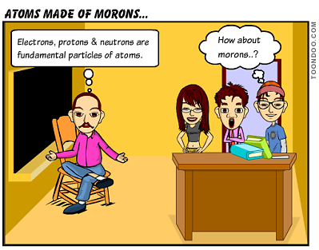
What makes up an Atom?
I will be able to describe and identify the parts that make up an atom.
Parts of the Atom
Subatomic particles
Nucleus – small dense center of the atom.
Contains
Protons = + Charge
Neutrons
Neutral Charge
Electron Cloud- surrounds the nucleus
Electrons = - charge

Slide 4
What makes up an Atom?
I will be able to describe and identify the parts that make up an atom.
Parts of the Atom
Proton-
Subatomic particle found in the nucleus of an atom.
Positive charge.
+

Slide 5
What makes up an Atom?
I will be able to describe and identify the parts that make up an atom.
Parts of the Atom
Neutron-
Subatomic particle found in the nucleus of an atom.
Neutral charge.
n

Slide 6
What makes up an Atom?
I will be able to describe and identify the parts that make up an atom.
Parts of the Atom
Electron-
Smallest Subatomic particle
Negative charge
Found orbiting in the electron cloud outside the nucleus.
_

Slide 7
What makes up an Element?
I will be able to describe what an Element is and how to use the Periodic Table.
Element
A substance composed of a single kind of atom.
H
Hydrogen
He
Helium
C
Carbon
N
Nitrogen
O
Oxygen
Ne
Neon
Na
Sodium
Mg
Magnesium
Al
Aluminum
Si
Silcon
Ar
Argon
Ca
Calcium
Fe
Iron
Au
Gold

Slide 8
What makes up an Element?
I will be able to describe what an Element is and how to use the Periodic Table.
Elements
Each element is identified by its atomic number.
Equal to the number of protons
Chlorine has 17 Protons
Also equal to the number of electrons
Chlorine
17
Cl
35.45

Slide 9
What is the Periodic Table?
I will be able to describe what an Element is and how to use the Periodic Table.
Periodic Table
Chlorine
Element Name
Atomic #
17
Cl
Indicates the number of Protons.
Chemical Symbol
1-2 letter abbreviation
1st letter capitalized
2nd always lowercase
Atomic Mass
35.45
The weighted Average of the masses of the naturally occurring isotopes.

Slide 10
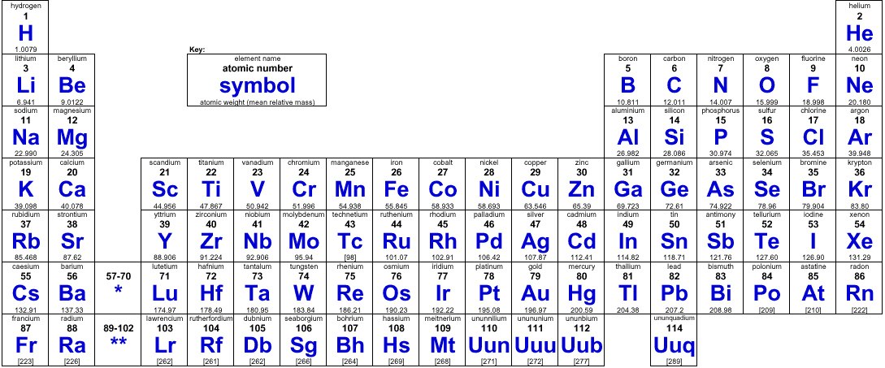
What is the Periodic Table?
I will be able to describe what an Element is and how to use the Periodic Table.
Periodic Table
A table created by Mendeleev
Arranged the elements according to their atomic numbers
Revealed patterns among the element’s properties.
Elements in each column share similar properties.

Slide 11
What is The Periodic Table?
I will be able to use the info displayed on the periodic table to determine characteristics of the elements.
Chlorine
Periodic Table
17
Cl
Atomic #
Atomic Mass
(round this number)
35.45
# Protons = Atomic Number
# Neutrons = Atomic Mass - Atomic Number
# Electrons = Atomic Number

Slide 12
What is The Periodic Table?
I will be able to use the info displayed on the periodic table to determine characteristics of the elements.
Periodic Table
P
Hydrogen
=
1
H
N
=
E
1.01
=

Slide 13
What is The Periodic Table?
I will be able to use the info displayed on the periodic table to determine characteristics of the elements.
Periodic Table
P
=
Oxygen
8
O
N
=
E
15.99
=

Slide 14
What is The Periodic Table?
I will be able to use the info displayed on the periodic table to determine characteristics of the elements.
Periodic Table
P
=
Iron
26
Fe
N
=
E
55.84
=

Slide 15
What is The Periodic Table?
I will be able to use the info displayed on the periodic table to determine characteristics of the elements.
Periodic Table
P
=
Nitrogen
7
N
N
=
E
14.00
=

Slide 16
What is The Periodic Table?
I will be able to use the info displayed on the periodic table to determine characteristics of the elements.
Periodic Table
P
=
Gold
79
Au
N
=
E
196.97
=

Slide 17
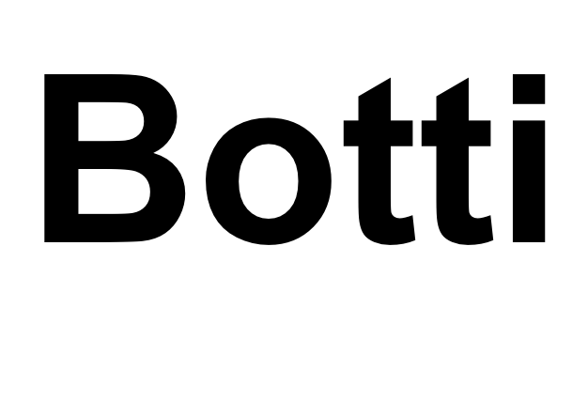
Compounds, Mixtures and Solutions
Earth Science Intro Unit

Slide 18
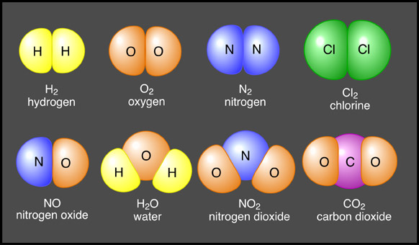
What is a Compound?
I will be able to define and describe the differences between compounds and mixtures.
Compounds
a substance made up of different kinds of atoms chemically combined.
Has different properties from the elements that make them up
Ex. NaCl – salt (table salt)
Na= sodium ; a solid that explodes when it comes in contact with any form of water
Cl= a poisonous gas

Slide 19
How to Count Atoms
I will be able to count atoms in various examples of compounds.
Counting Atoms
Hydrogen (H₂)
Hydrogen =
Water (H₂O)
Hydrogen =
Oxygen =
Nitrogen Oxide (NO)
Nitrogen =
Oxygen =
Sugar (C₆H₁₂O₆)
Carbon =
Hydrogen =
Oxygen =

Slide 20
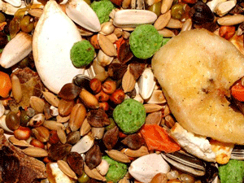
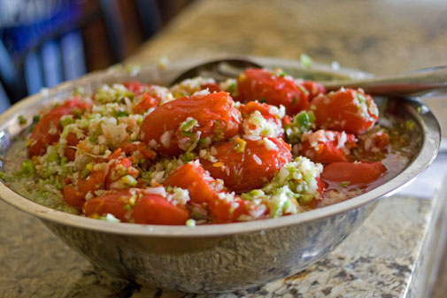
What is a Mixture?
I will be able to define and describe the differences between compounds and mixtures.
Mixtures
two or more substances that are combined physically not chemically
Made of many different kinds of particles that can usually be separated.

Slide 21
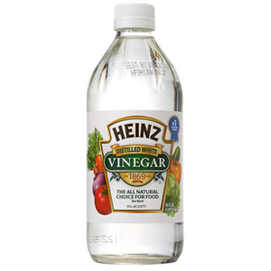
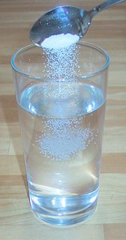
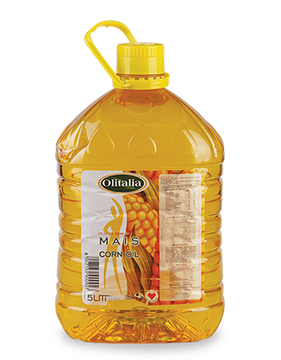
What is a Mixture?
I will be able to define and describe the differences between compounds and mixtures.
Examples of Mixtures
Homogeneous – substances in the mixture are evenly spread out.
Uniform composition
Air
Corn Oil
Vinegar
Solutions- (salt water)

Slide 22
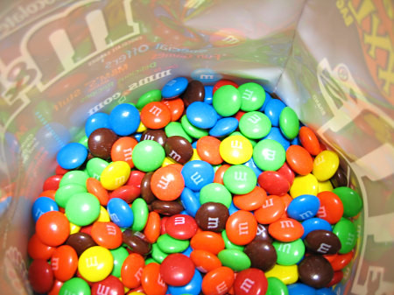
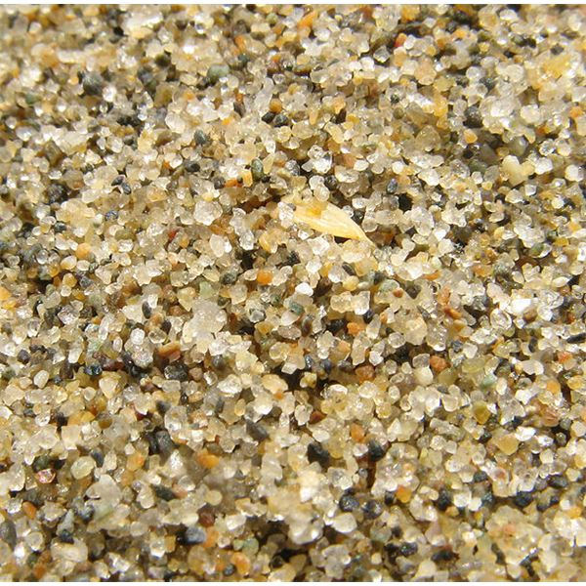
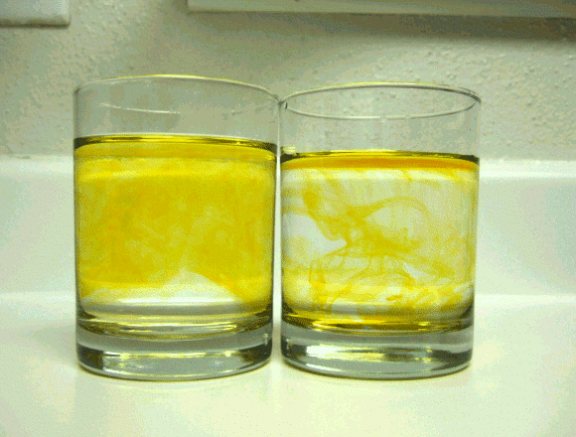
What is a Mixture?
I will be able to define and describe the differences between compounds and mixtures.
Examples of Mixtures
Heterogeneous – a mixture that lacks a uniform composition
Rocks- made up of minerals in different proportions.
Sand at the beach.
Vinegar and Oil

Slide 23
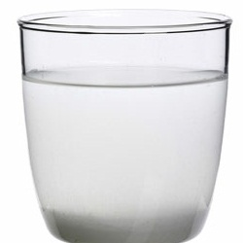
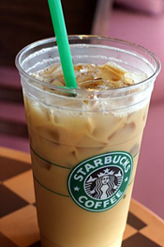
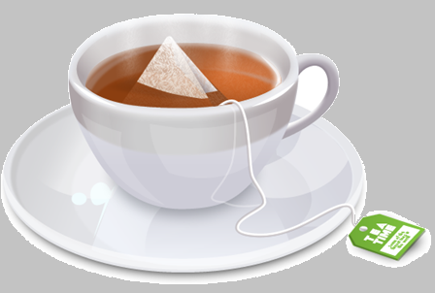
What is a Solution?
I will be able to define and describe what a solution is.
Solutions
Different kind of mixture, homogeneous mixture
One substance is dissolved in another substance
Ex. Salt dissolved in water,
Coffee
Tea

